Slide 1
Expert system for manufacturing process
B.Tech Project
Team Member
Abhishek Upadhyay (16ucs013)
Ashish Gupta (16ucs048)
Nimish Gupta (16ucs119)
Raja Singhal (16ucs151)
Mentors
Dr. Bharavi Mishra
Dr. Manoj Kumar
13 Dec 2019

Slide 2
Outline
OBJECTIVE
INTRODUCTION
SUBMERGED ARC WELDING
PROBLEM & CURRENT SCENARIO
SOLUTION
DATASET COLLECTION (VERSION 1.O)
MODEL SELECTION & IMPLEMENTATION
UPDATION IN PREVIOUS WORK
DATASET COLLECTION (VERSION 2.O)
FINAL RESULTS & CONCLUSIONS
FUTURE IMPROVEMENTS

Slide 3
Objective
Design an expert system for manufacturing in the field of welding, such that the efficiency of process will increase.
Welders having less hands-on experience on welding can use easily.
Reduce hit & error process for require welding.

Slide 4
Introduction
Welding is the process by which two pieces of metal can be joined together through the use of extreme heat.
We are trying to automate submerged arc welding(SAW) process by using Deep Learning models.
SAW is mechanised process in which input parameters are selected by trial and error method which affects time and efficiency.
Our model will reduce number of trails and hence increase the probability of getting required welding.
In our model the desired output will be used as input and model will accordingly predict the parameter required to get the desired output.

Slide 5
What is manufacturing system?
Manufacturing is arrangement and operation of machines, tools, material, people.
Information to produce a useful physical, informational or service product whose success and cost is characterized by measurable parameters.
What is welding?
Join together (metal parts) by heating the surfaces to the point of melting with the help of blowpipe, electric arc, or other means, and joining them by pressing, hammering.
There are lots of welding but we choose submerged arc welding for our model.

Slide 6
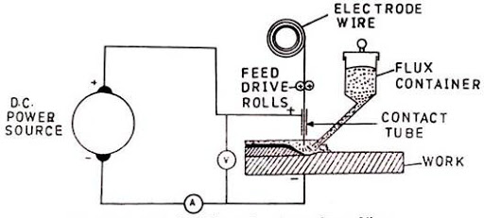
Schematic diagram for the SAW process

Slide 7
Problem and Current Scenario
Welding is done manually by trial and error.
It requires highly qualified professionals.
They make use of their experience and knowledge of previous experiments and theories to get required weld.
In this modern world where everything is automated but welding, which plays an important role in our daily life still done through old methodology which is trial and error.

Slide 8
Solution
As there is great requirement of welders for welding but due to some reasons it can’t be fulfilled.
So we’re designing an expert system using deep learning to overcome this problem.
We use previous welding data for designing our system and make predictions accordingly.
As we learn from our experience, so our model will.
Welder will input his requirement and get result which will be used to get a required weld.

Slide 9
Model V1.0 Dataset Collection
Dataset that we have used is an experimented dataset which was already tested in research papers.
Dataset we have accommodated together is not from a single research paper, it is collected from more the 150+ research papers of SAW experiments.
Crawler is used to get research papers from different websites.

Slide 10
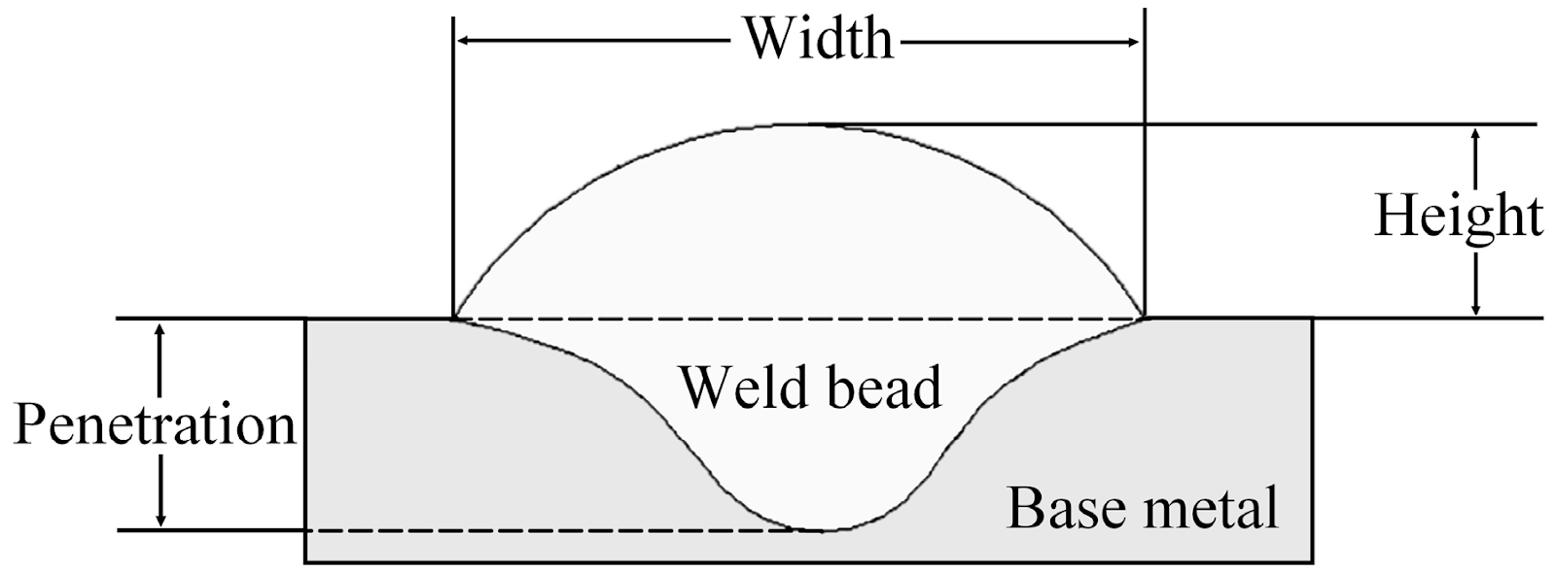
Input / Output Parameters For Our System
Input parameters:
Bead-width
Reinforcement height
Penetration
Output parameters:
Voltage
Wire feed rate
Welding speed
Nozzle to plate distance

Slide 11
Input Parameters
Bead width
It is the maximum width of deposited weld metal.
It is directly proportional to the arc current, welding voltage, and inversely proportional to the welding speed.
Reinforcement Height
It is the bead height above the surface of the plate.
Reinforcement is inversely proportional to welding voltage.

Slide 12
Penetration
Penetration is the maximum distance from the surface of the base plate to the depth of fusion.
Penetration is directly proportional to the welding current and inversely proportional to the welding speed.

Slide 13
Output Parameters
Voltage:
The voltage is a deciding factor for the shape of the weld bead cross- section.
Wire Feed Rate:
The rate at which the welding metal shaped in wire form is feeding into welding machine.
Nozzle to plate distance:
The NTPD influences the development of the weld pool by changing the arc length and welding current.

Slide 14
Welding Speed:
It is the rate at which the arc moves along the joint to be welded and influences the heat input per unit length of the weld.
Increased welding speed results in uneven bead shape.
Slow welding speed facilitates escape of gases from the molten metal, thereby reducing porosity.

Slide 15
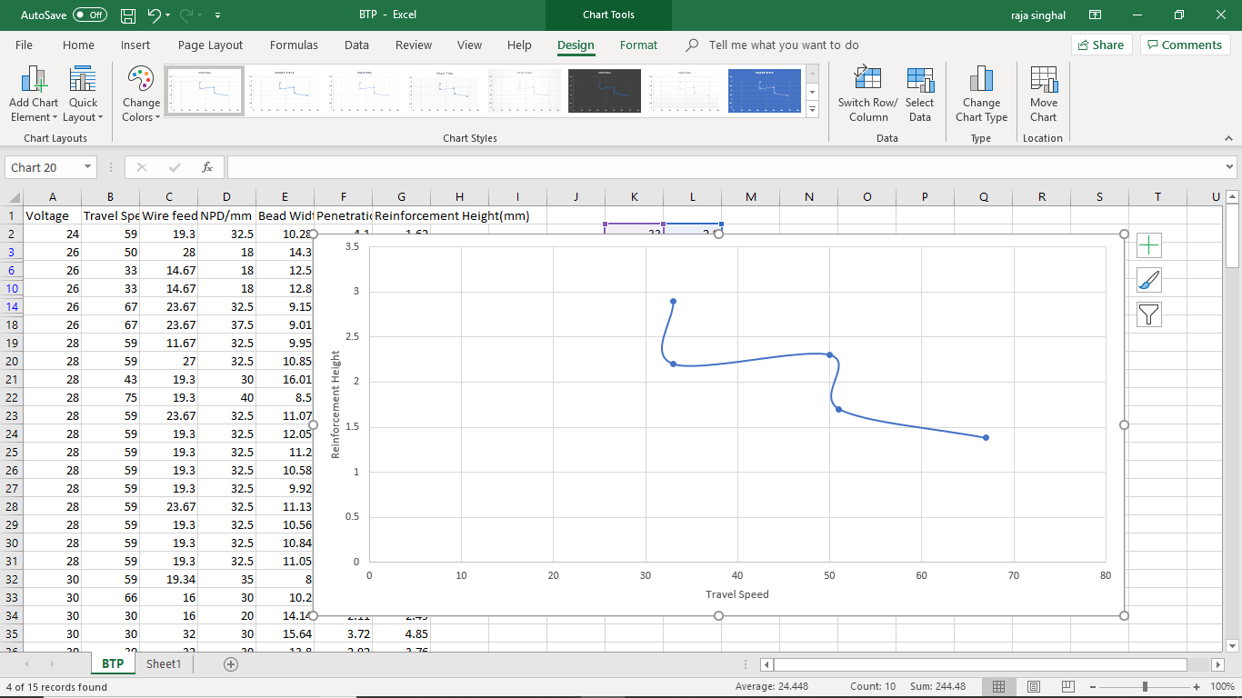
Height vs Travel speed

Slide 16
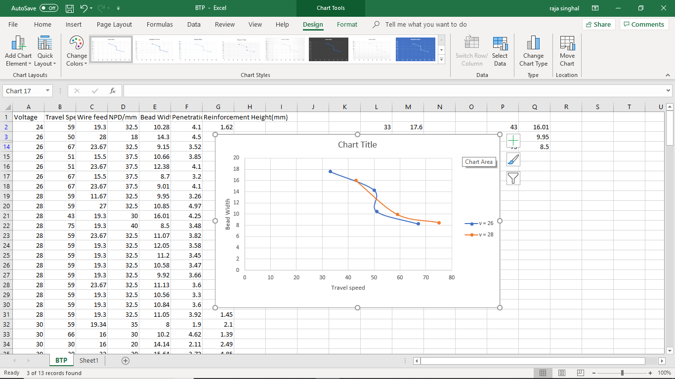
Bead Width vs Travel speed

Slide 17
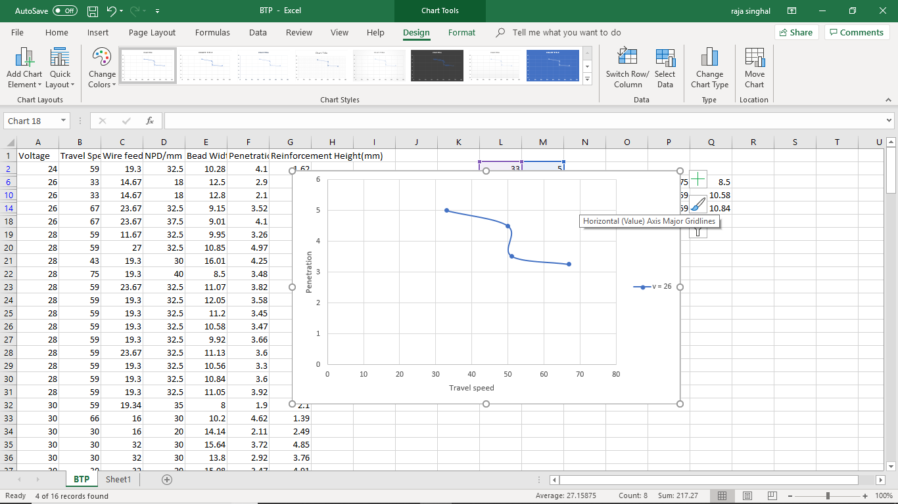
Penetration vs Travel speed

Slide 18
Model selection process

Slide 19

Regression
It is used to predict values in a one to one mapping. It is a deterministic model.
Some of its types are Linear regression(Y=a+bX) or polynomial regression etc.
For our model we need probabilistic method to predict data because it is more accurate and efficient as compare to the deterministic approach that’s why we used neural networks in our model.
We have also used regression in dummy data generation which will be explained in the slides below.

Slide 20
RNN
The Recurrent Neural Network(RNN) is basically used for text generation, text and speech recognition.
It is also used for natural language processing (NLP).
We have applied this neural network to train our model but accuracy of the data that is generated is low because In our model we are basically dealing with numerical input and output values thats why this model is less suitable for our model.

Slide 21
CNN
In neural networks, Convolutional neural network (ConvNets or CNNs) is one of the main categories to do images recognition, images classifications. Objects detections, recognition faces etc, are some of the areas where CNNs are widely used.
In our model we are not dealing with any image recognition so this model is less suitable for our model.

Slide 22
ANN
We selected Artificial neural network (ANN) as our prediction model, for this welding process.
We use keras neural-network library for ANN implementation. We use this because of its user-friendly, modular, and extensible features.
ANN consists of many interconnected processors known as neurons that are simple processors which operate in parallel.
Every neuron is connected with other neuron through a connection link.
Each connection link is associated with a weight that has information about the input signal.

Slide 23

Choosing a correct model
Regression
RNN (primarily used for NLP)
CNN (primarily used for Image processing)
ANN

Slide 24
Why we use ANN?
Because we have:
Non-linear relationship in our dataset.
Many to many (Multiple output for multiple inputs)
ANN is good for Numerical value prediction.
In ANN we used keras library for ANN implementation.

Slide 25
Error or loss function
Error is calculated as the difference between actual output and predicted output, model learns by loss function.
We need to minimize the error for more accurate predictions. It is done by Back Propagation.
The current error is propagated backwards to previous layer, where weights are modified.
Weights are modified using function called Optimization Function.
We use MSE (Mean square error) as error function in the model.

Slide 26
Optimization Function
Optimization algorithms helps us to minimize (or maximize) an Error function.
It is used to update weight, which will reduce the error of the model.
We’ve used Adam, (Adaptive Moment Estimation)

Slide 27
Activation Function
Activation function decides whether a neuron should be activated or not.
Activation function decides whether a neuron is activated or not.
The purpose of the activation function is to introduce non-linearity into the output of a neuron.
We use ReLU as a activation function for this model.

Slide 28
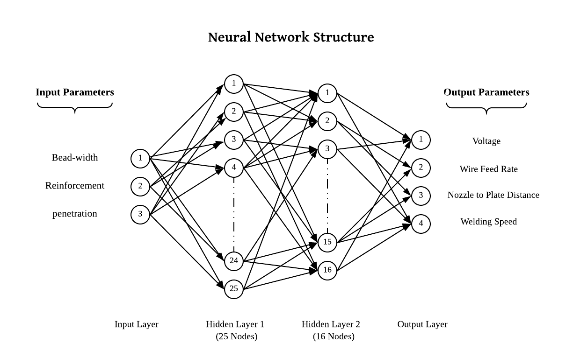

Slide 29
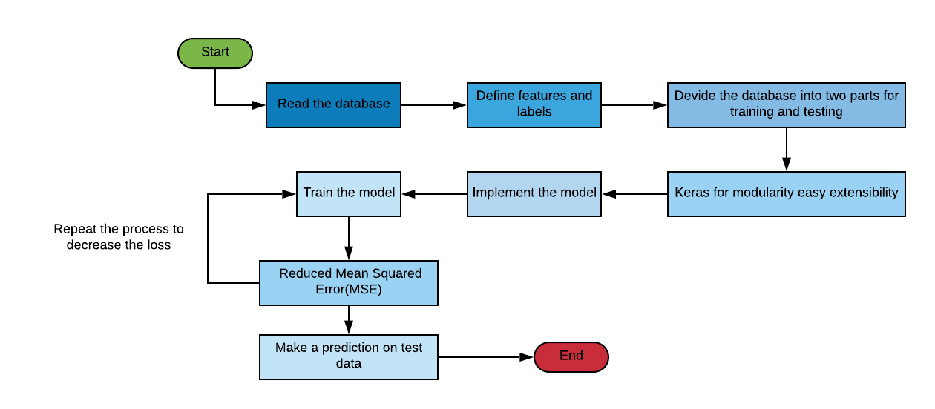
Process diagram for ANN:-

Slide 30
Predicted values VS Actual values in Model 1.0
Actual and Predicted Outputs |  |  |  |  | Input for Our System
 | Voltage | Travel Speed(cm/min) | Wire feed Rate(mm/s) | NPD(mm) | Bead Width (mm) | Penetration (mm) | Reinforcement Height(mm)
Actual-1 | 30 | 59 | 19.34 | 35 | 8 | 1.9 | 2.1
Predicted-1 | 34.26736 | 63.2129 | 16.1139 | 31.7726
Actual-2 | 36 | 54 | 21 | 30 | 13 | 3.5 | 2.4
Predicted-2 | 32.1413 | 49.8787 | 18.8217 | 26.8739

Slide 31
Results
RMS error value : 0.98
Accuracy : Accuracy is approx 68%
Reason : Dataset is less so Deep Learning is not effectively applicable

Slide 32
Updates we did in new session of our BTP

Slide 33
Data Collection Process

Slide 34
FIN temperature dataset
We used verified mathematical formulas for creating 1500 rows of data for this process.
Pros:
We get 1500 lines of dataset by using all possible combinations of inputs.
Problem:
One output parameter depended on 5 parameters but another parameter depended only on two parameters. Which creates data duplicacy and saturation in dataset.

Slide 35
temp_air = 486 - (1.12*fl) - (1.44*ft) + (8.3*fg) - (0.33*ctd) + (0.02*ctl) + (0.35*fl*ft) -(0.19*fl*fg) - (0.92*ft*fg) + (0.022*ft*ctl);
temp_water = 241.48 - (7.12*fl) + (6.44*ft) - (1.37*ctd);
fl | ft | fg | ctd | ctl | temp_air | temp_water
10 | 2 | 4 | 10 | 60 | 497.7 | 169.46
10 | 2 | 4 | 10 | 70 | 498.34 | 169.46
10 | 2 | 4 | 10 | 80 | 498.98 | 169.46
10 | 2 | 4 | 10 | 90 | 499.62 | 169.46
10 | 2 | 4 | 10 | 100 | 500.26 | 169.46
10 | 2 | 4 | 15 | 60 | 496.05 | 162.61
10 | 2 | 4 | 15 | 70 | 496.69 | 162.61
10 | 2 | 4 | 15 | 80 | 497.33 | 162.61
10 | 2 | 4 | 15 | 90 | 497.97 | 162.61
10 | 2 | 4 | 15 | 100 | 498.61 | 162.61
10 | 2 | 4 | 20 | 60 | 494.4 | 155.76

Slide 36
Come back to previous welding dataset
Steps are used for generation dummy dataset:
Regression for generating mathematical formula for bead width, penetration and reinforcement height.
Generate 1500 values for Voltage, WRF, NPD, WS by using random function in the given parameter ranges (in research paper).
Check number of unique rows and remove duplicate rows.
Did this process with 3 different sets of experiment results
That is how we generate 4500 lines of dummy data using 90 lines of dataset.

Slide 37
Regression model for dummy dataset-1
Apply regression on each parameter ( W, H, P) and find mathematical relations with other parameter (V, WFR, WS, NPD).
Used 32 lines of experimental data for regression process.
Linear Regression:
R² value for W = 0.84
R² value for H = 0.55
R² value for P = 0.70
Polynomial Regression (degree 2):
R² value for W = 0.97
R² value for H = 0.88
R² value for P = 0.79

Slide 38
Regression Code for W

Slide 39
from google.colab import files
uploaded = files.upload()
import io
import pandas as pd
import numpy as np
from sklearn.metrics import mean_squared_error, r2_score
from sklearn.preprocessing import PolynomialFeatures
import matplotlib.pyplot as plt
dataframe = pd.read_csv(io.BytesIO(uploaded['regression data set ashish - Sheet1.csv']))
X = dataframe.iloc[:,0:4]
y = dataframe.iloc[:,-1]

Slide 40
from sklearn.linear_model import LinearRegression
lr = LinearRegression()
lr.fit(X,y)
y_pred = lr.predict(X)
rmse = np.sqrt(mean_squared_error(y,y_pred))
r2 = r2_score(y,y_pred)
print(rmse)
print(r2)
0.8538341917127381
0.8437372971553625

Slide 41
polynomial_features= PolynomialFeatures(degree=2)
x_poly = polynomial_features.fit_transform(X)
model = LinearRegression()
model.fit(x_poly, y)
y_poly_pred = model.predict(x_poly)
rmse = np.sqrt(mean_squared_error(y,y_poly_pred))
r2 = r2_score(y,y_poly_pred)
print(rmse)
print(r2)
Model.coef_
0.3793128359264996
0.9691607841530744
array([ 0.00000000e+00, -1.79187724e+00, 9.67760085e-01, 6.62476469e+00,
-8.03223064e-02, 9.90754705e-02, 3.78289474e-03, -2.66346154e-01,
-1.75000000e-02, -1.25511543e-02, -5.99696356e-02, 3.02631579e-03,
1.55029981e-01, -7.00000000e-02, 1.82083011e-02])

Slide 42
Polynomial_features.powers_
Model1intercept_
array([[0, 0, 0, 0],
[1, 0, 0, 0],
[0, 1, 0, 0],
[0, 0, 1, 0],
[0, 0, 0, 1],
[2, 0, 0, 0],
[1, 1, 0, 0],
[1, 0, 1, 0],
[1, 0, 0, 1],
[0, 2, 0, 0],
[0, 1, 1, 0],
[0, 1, 0, 1],
[0, 0, 2, 0],
[0, 0, 1, 1],
[0, 0, 0, 2]])
-8.568681882063727
Same process with height and penetration for each dataset (3)

Slide 43
array([
-1.79187724e+00, 9.67760085e-01, 6.62476469e+00,
-8.03223064e-02, 9.90754705e-02, 3.78289474e-03, -2.66346154e-01,
-1.75000000e-02, -1.25511543e-02, -5.99696356e-02, 3.02631579e-03,
1.55029981e-01, -7.00000000e-02, 1.82083011e-02
])
Intercept (C) = -8.568681882063727
W = X1*V + X2*WFR + X3*WS + X4*NPD + X5*V*V + X6*V*WFR + X7*V*WS + X8*V*NPD + X9*WFR*WFR + X10*WFR*WS + X11*WFR*NPD + X12*WS*WS + X13*WS*NPD + X14*NPD*NPD + C

Slide 44
Actual dataset VS Dummy dataset
H(mm) | P(mm) | W (mm)
1.7 | 3.52 | 10.15
1.51 | 3.4 | 13.37
1.85 | 4.1 | 15.64
1.38 | 3.25 | 8.28
1.18 | 3.18 | 10.1
1.5 | 3.52 | 9.15
1.48 | 3.6 | 14.45
1.92 | 4.1 | 12.38
1.8 | 3.8 | 15.96
1.37 | 3.2 | 8.7
1.5 | 3.88 | 10
H(mm) | P(mm) | W (mm)
1.723151368 | 3.697078008 | 10.09636714
1.551901367 | 3.574578009 | 14.02553381
1.946111581 | 4.186626949 | 15.43446537
1.282262979 | 3.147470854 | 8.3430684
1.208512978 | 3.084970855 | 10.04347351
1.596473193 | 3.894519793 | 8.993238402
1.443151368 | 3.432078013 | 14.63136714
1.951111583 | 4.401626952 | 12.46113203
1.799861582 | 4.014126953 | 16.0552987
1.33351298 | 3.319970858 | 8.830140167
1.506473194 | 3.809519798 | 10.0782384

Slide 45
Predicted values VS Actual values in Model 2.0
V(Volt) | WFR(mm/s) | WS(mm/s) | NPD(mm)
33.187992 | 24.365698 | 7.443649 | 29.321726
47.07379 | 25.762974 | 7.5075326 | 30.860222
44.35186 | 20.866597 | 8.625528 | 25.78757
44.35186 | 20.966597 | 9.125528 | 25.78757
40.912045 | 22.15865 | 8.182539 | 27.428703
36.371445 | 22.551788 | 8.022822 | 27.713243
47.92977 | 25.7628 | 9.959516 | 30.87189
V(Volt) | WFR(mm/s) | WS(mm/s) | NPD(mm)
33 | 24.5 | 6 | 29.5
48 | 25.5 | 7.5 | 30.5
45 | 20.5 | 8.5 | 25.5
45 | 21 | 9.5 | 26
38 | 22 | 8.5 | 27
35 | 22 | 8 | 27
48 | 26.5 | 10 | 31.5

Slide 46
Results and future improvements
Accuracy is approx 75% to 80%
RMS error value : 0.70
Successfully generated 4500 lines of data which will help in future model improvement or other researches.
Future Improvements:
As this accuracy is not very good for welding, so this model still needs future improvements.
Also temperature and surrounding plays an important role in welding process which is not taken into account in this model.
After integration of all three dataset, we will need more powerful algorithm for prediction.

Slide 47
Model Code

Slide 48
import io
import pandas as pd
import numpy as np
from sklearn.preprocessing import StandardScaler,MinMaxScaler
from sklearn.model_selection import train_test_split
dataframe = pd.read_csv(io.BytesIO(uploaded['data using regression-2 (A) - Sheet1.csv']))
X = dataframe.iloc[:,-3:]
y = dataframe.iloc[:,0:4]
X_train, X_test, y_train, y_test = train_test_split(X, y, test_size = 0.25, random_state = 1)
sc = StandardScaler()
X_train = sc.fit_transform(X_train)
X_test = sc.transform(X_test)
sc_y = StandardScaler()
y_train = sc_y.fit_transform(y_train)
y_test = sc_y.transform(y_test)

Slide 49
from keras.models import Sequential
from keras.layers import Dense
classifier = Sequential()
classifier.add(Dense(units = 12, kernel_initializer = 'random_uniform', activation = 'relu', input_dim = 3))
classifier.add(Dense(units = 8, kernel_initializer = 'random_uniform', activation = 'relu'))
classifier.add(Dense(units = 4))
classifier.compile(optimizer = 'adam',loss = 'mean_squared_error', metrics=['accuracy'])
classifier.fit(X_train, y_train, validation_split=0.25,batch_size = 1, epochs = 10)

Slide 50
y_pred = classifier.predict(X_test)
import math
from sklearn.metrics import mean_squared_error
error = math.sqrt(mean_squared_error(y_test, y_pred))
print(error)
#------------------------------------------------------------------
#tr = np.array([160,2.96, 5.54, 13.40])
tr = np.array([1.716507836, 3.559318965, 10.17178424])
# tr = np.array([2.00925707, 4.501183971, 14.90055334])
tr = np.reshape(tr ,(1,-1))
tr = sc.transform(tr)
yx = classifier.predict(tr)
yx = sc_y.inverse_transform(yx)
print(yx)
classifier.evaluate(X_test,y_test) // getting arruracy value

Slide 51
Dataset references
Las-Casas, M.S., de Ávila, T.L.D., Bracarense, A.Q. et al. J Braz. Soc. Mech. Sci. Eng. (2018) 40: 26. https://doi.org/10.1007/s40430-017-0928-0
Gunaraj, V., and N. Murugan. "Application of response surface methodology for predicting weld bead quality in submerged arc welding of pipes." Journal of Materials Processing Technology 88.1-3 (1999): 266-275.
Murugan, N., & Gunaraj, V. (2005). Prediction and control of weld bead geometry and shape relationships in submerged arc welding of pipes. Journal of Materials Processing Technology, 168(3), 478-487.
Chandel, R. S., Seow, H. P., & Cheong, F. L. (1997). Effect of increasing deposition rate on the bead geometry of submerged arc welds. Journal of Materials Processing Technology, 72(1), 124-128.

Slide 52
Dataset references
Choudhary, A., Kumar, M., & Unune, D. R. (2019). Experimental investigation and optimization of weld bead characteristics during submerged arc welding of AISI 1023 steel. Defence Technology, 15(1), 72-82.
Singh, K., & Pandey, S. (2009). Recycling of slag to act as a flux in submerged arc welding. Resources, Conservation and Recycling, 53(10), 552-558.

Slide 53
Thank You !

